Slide 1
Section 11.6
Polar Equations of Conics
Copyright © 2012 Pearson Education, Inc. Publishing as Prentice Hall.

Slide 2
Copyright © 2012 Pearson Education, Inc. Publishing as Prentice Hall.

Slide 3
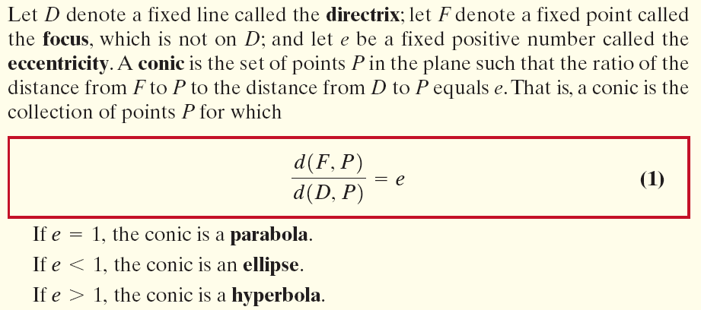

For both an ellipse and a hyperbola, the eccentricity e satisfies
where c is the distance from the center to the focus and a is the distance from the center to a vertex.
Copyright © 2012 Pearson Education, Inc. Publishing as Prentice Hall.

Slide 4
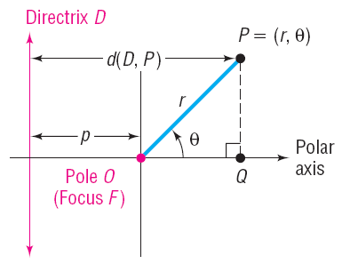

Copyright © 2012 Pearson Education, Inc. Publishing as Prentice Hall.

Slide 5

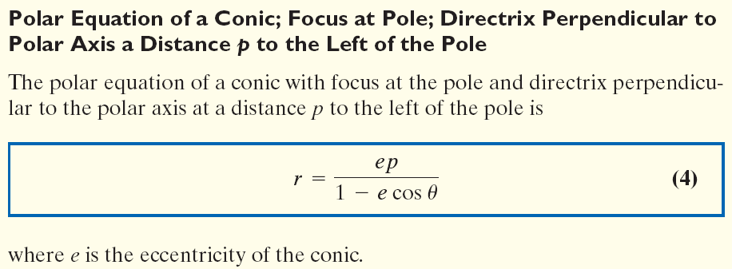
Copyright © 2012 Pearson Education, Inc. Publishing as Prentice Hall.

Slide 6

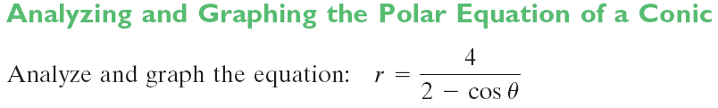
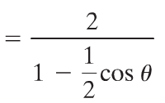
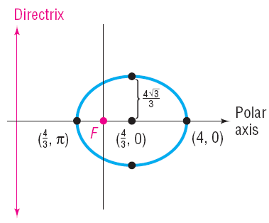

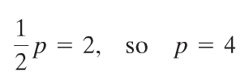

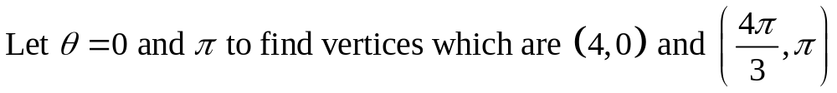
Divide numerator and denominator by 2
One focus is at the pole and the directrix is perpendicular to the polar axis 4 units to the left of the pole.
Copyright © 2012 Pearson Education, Inc. Publishing as Prentice Hall.

Slide 7
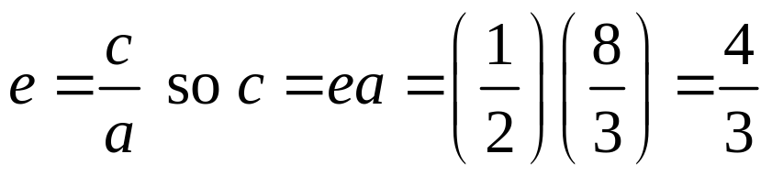


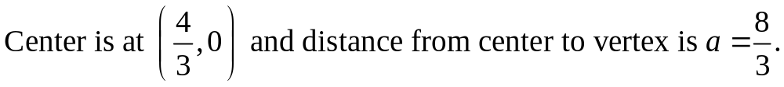
Copyright © 2012 Pearson Education, Inc. Publishing as Prentice Hall.

Slide 8
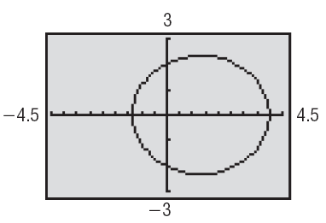




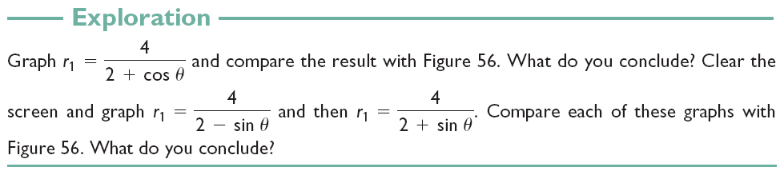



Copyright © 2012 Pearson Education, Inc. Publishing as Prentice Hall.

Slide 9

The polar equation of a conic with focus at the pole and directrix perpendicular to the polar axis at a distance p units to the right of the pole is
where e is the eccentricity.
Copyright © 2012 Pearson Education, Inc. Publishing as Prentice Hall.

Slide 10
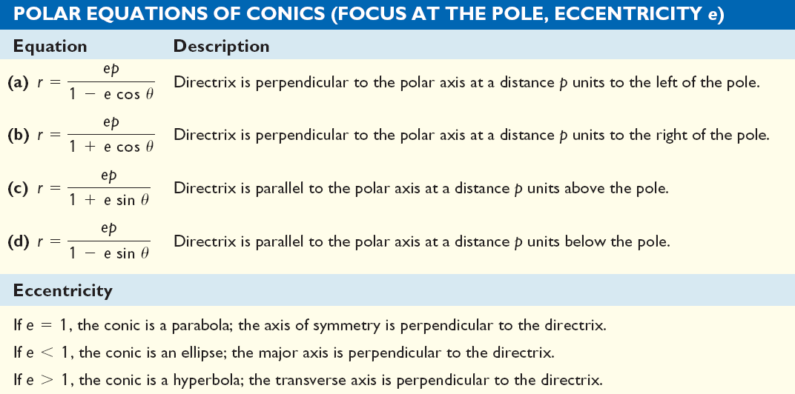
Copyright © 2012 Pearson Education, Inc. Publishing as Prentice Hall.

Slide 11
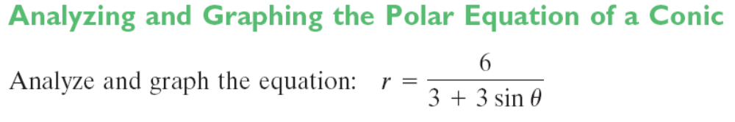



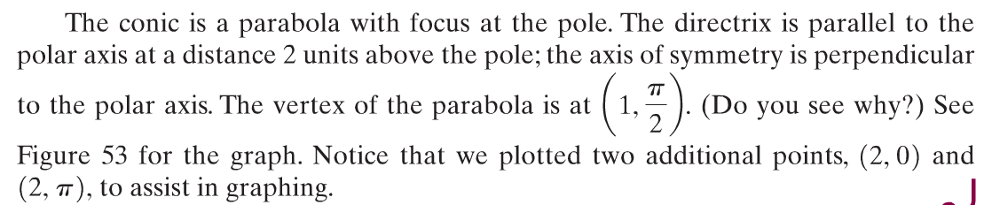
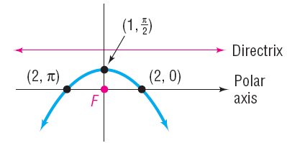

Copyright © 2012 Pearson Education, Inc. Publishing as Prentice Hall.

Slide 12
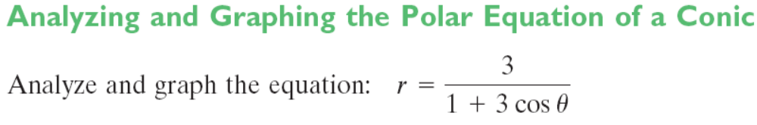
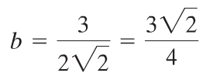



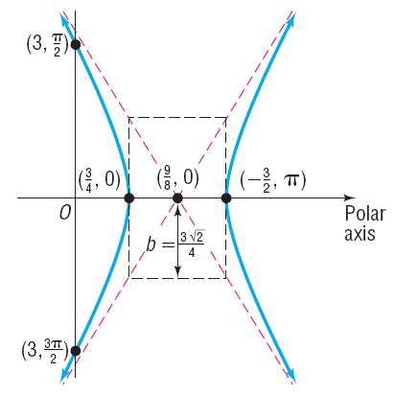
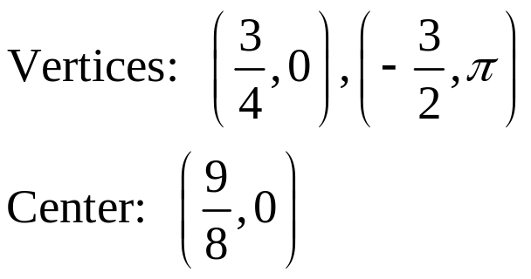
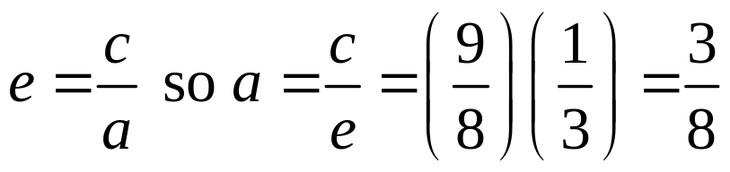

The directrix is perpendicular to the polar axis on unit to the right of the pole and the transverse axis is along the polar axis.
Copyright © 2012 Pearson Education, Inc. Publishing as Prentice Hall.

Slide 13

Copyright © 2012 Pearson Education, Inc. Publishing as Prentice Hall.

Slide 14
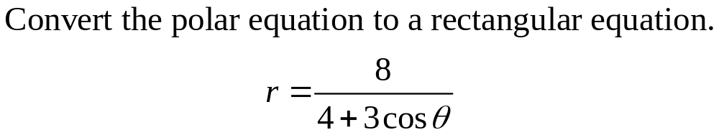
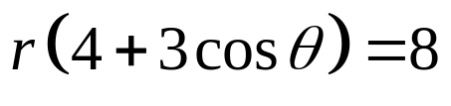
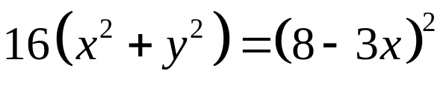




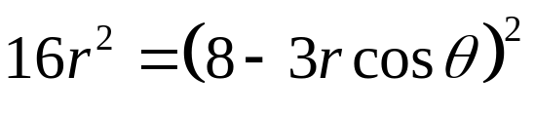

Copyright © 2012 Pearson Education, Inc. Publishing as Prentice Hall.

